Slide 1
Predicting Box Office Success: A Data-Driven Approach for Movie Performance Forecasting

Slide 2




GROUP MEMBERS
ROBASS ATIF
MOHAMMAD TAYYAB
MOHAMMAD AHMAD
MOHAMMAD SAAD AKMAL

Slide 3
TABLE OF CONTENTS
01
02
03
04
05
06
Introduction and Motivation
Related Work
Dataset and Method
Learning Models
Results and Analysis
Future work

Slide 4
Problem Statement
The film industry plays a pivotal role in global entertainment, shaping societal norms and evoking emotions. Predicting a movie's success has historically relied on intuition and simple statistical models, focusing on factors like cast reputation, director experience, and promotional efforts. However, these methods often fall short in today's data-rich environment With the advent of big data analytics and machine learning, filmmakers and stakeholders can now leverage vast amounts of historical and real-time data to uncover patterns and predict outcomes with greater accuracy. This shift toward data-driven approaches promises not only to optimize financial returns but also to better align films with audience preferences and industry trends.

Slide 5
Motivation
It aims to highlight the importance of leveraging a data-driven approach to predict box office success.
Emphasizes the practical application of predictive models in the movie industry for better decision -making.
Focuses on addressing challenges such as financial risk management and improving audience engagement through insights-driven strategies.

Slide 6
Related Work
Prediction accuracies range from 58% to 85%, showing scope for improvement
Key features like genre combinations and box-office competition are often missing.

Slide 7
Data collection
The dataset was obtained from IMDB having 27k rows and 24 columns
The dataset is composed of both categorical data (e.g., title, genres, status, original_language) and numerical data (e.g.,vote_average, revenue,budget, runtime).
The dataset includes movie details and performance data, enabling a full analysis of factors driving success.

Slide 8
Data preprocessing
Data Cleaning: Handled missing values; replaced numerical features with medians
Label Encoding: Encoded categorical features (e.g., seasons: Spring = 1, Summer = 2).
Feature Engineering: Added features like box-office competition and genre combination popularity.
Standardization: Scaled numerical features to ensure equal contribution during training.
Correlation Analysis: Identified strong relationships (e.g., revenue with budget and vote count).
Data Split: 80% for training, 20% for testing to validate model generalization.

Slide 9
Feature Extraction
Identify critical variables such as:
Genre
Budget
Star power
Select features that significantly impact movie success.

Slide 10
Results and Analysis
Key predictors: budget, genre, cast/director experience.
Evaluation metrics: MAE, RMSE, and R-squared.
Outliers influenced by viral success or negative reviews.

Slide 11
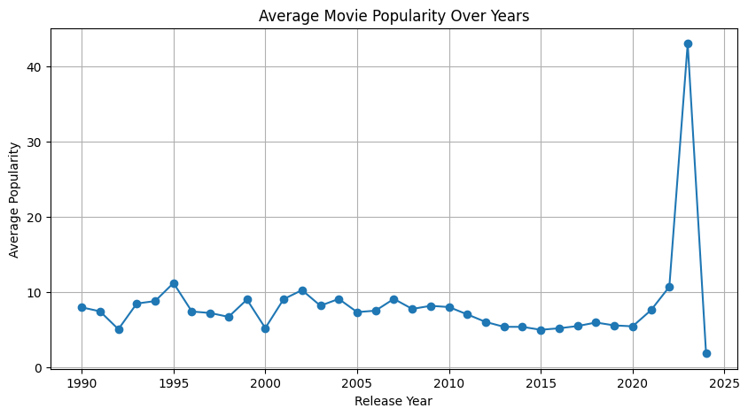
Analysis

Slide 12
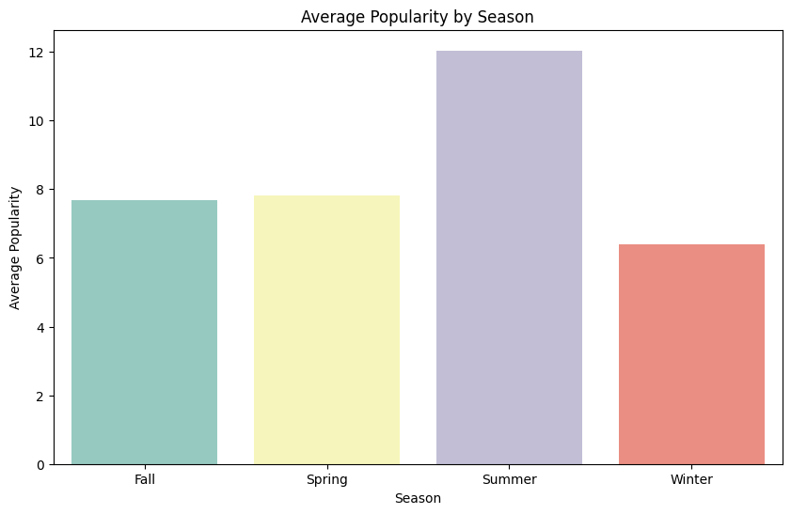
Analysis…

Slide 13
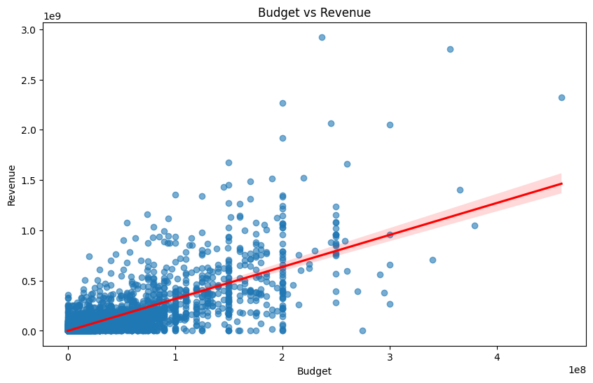
Analysis…

Slide 14
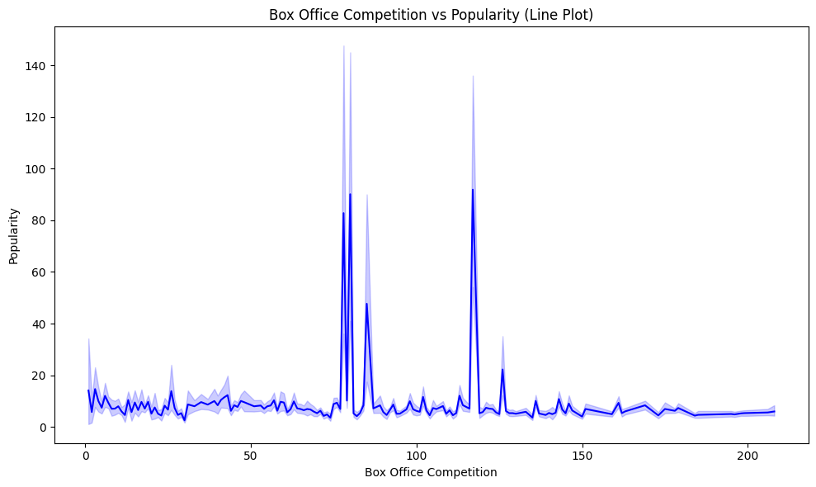
Analysis…

Slide 15
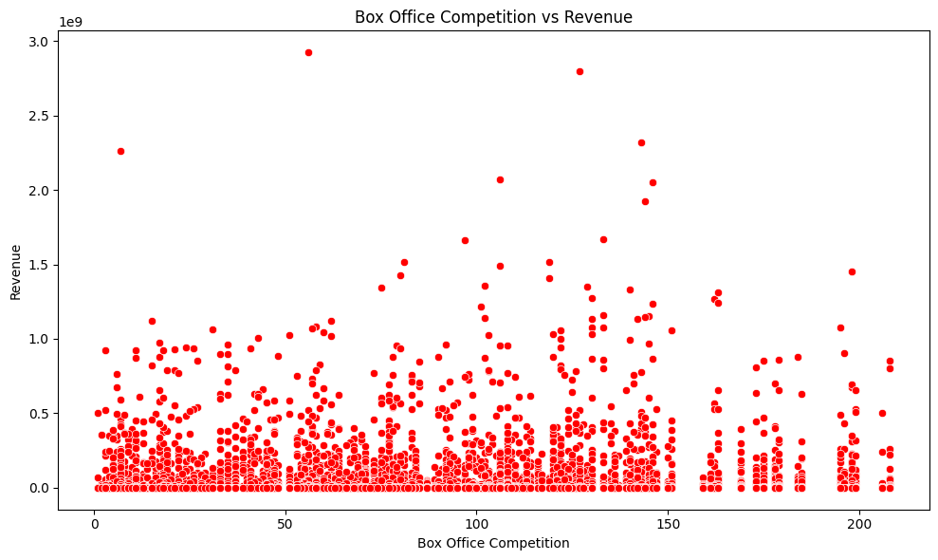
Analysis…

Slide 16
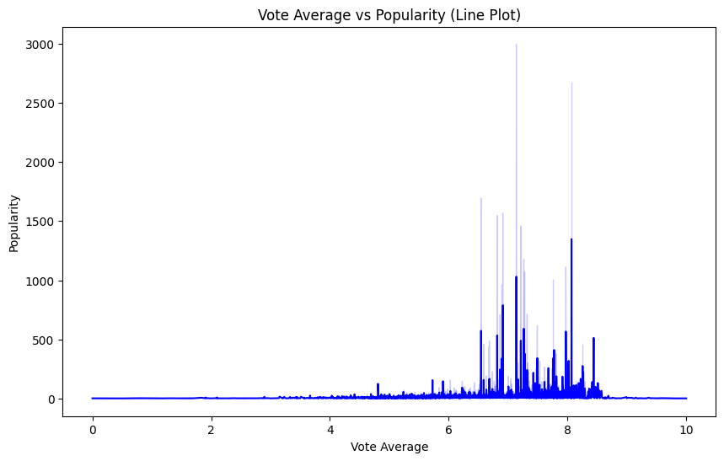
Analysis…

Slide 17
Models
Random Forest Regressor (RF)
Gradient Boosting Regressor (GB)
Stacking Regressor

Slide 18

ACCURACY OF MODEL
ACCURACY : 92 %

Slide 19
Future Work

Slide 20
Conclusion
Achieving an accuracy of 92%, this project provides valuable insights to help organizations predict movie success. These predictions enable studios to optimize marketing strategies, forecast box office performance, and enhance audience targeting. By leveraging advanced features, it supports better resource allocation and strategic planning.

Slide 21
THANKS!

Slide 22


